Slide 1


Data Governance @ SneakerPark
Prepared by: Jeffrey Lueken
Submitted on: 7/xx/2022

Slide 2
Background
SneakerPark is an online shoe reseller that allows people to buy and sell used and new shoes. Buyers can bid for shoes or buy them outright, and sellers can set a price or sell to the highest bidder.
Each buyer and seller must have an active account in order to sell, bid, or purchase sneakers using SneakerPark’s website.
SneakerPark authenticates the shoes before shipping them to the buyer, so before listing an item, the seller must ship it to SneakerPark’s warehouse. Upon receipt, SneakerPark assigns an item number to each pair of sneakers and notifies the seller that they are now free to list their item. If the item is not listed within 45 days, SneakerPark returns it to the seller and sends an invoice to the seller for the shipping cost.
If the item is found to be inauthentic or in an unacceptable condition, it is also returned back to the seller in a similar fashion.
When the item sells, the buyer’s account is credited with the purchase price minus the SneakerPark service fee and shipping fees to deliver the item to the buyer.
Currently, SneakerPark only supports sales within the United States.

Slide 3
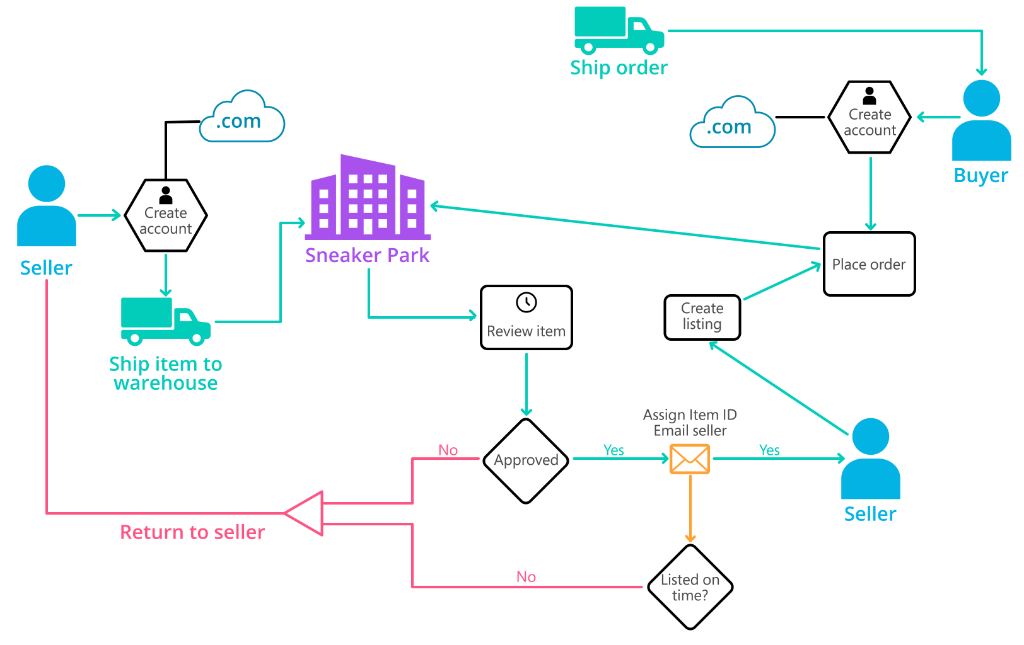
Background (cont’d)
Below you can see a diagram that will hopefully help you visualize some of SneakerPark's business processes. Keep in mind that it does not capture ALL processes and every nuance, but simply serves as another artifact to use in your project.

Slide 4
Step 1
Enterprise Data Catalog Part 1: Enterprise Data Model

Slide 5
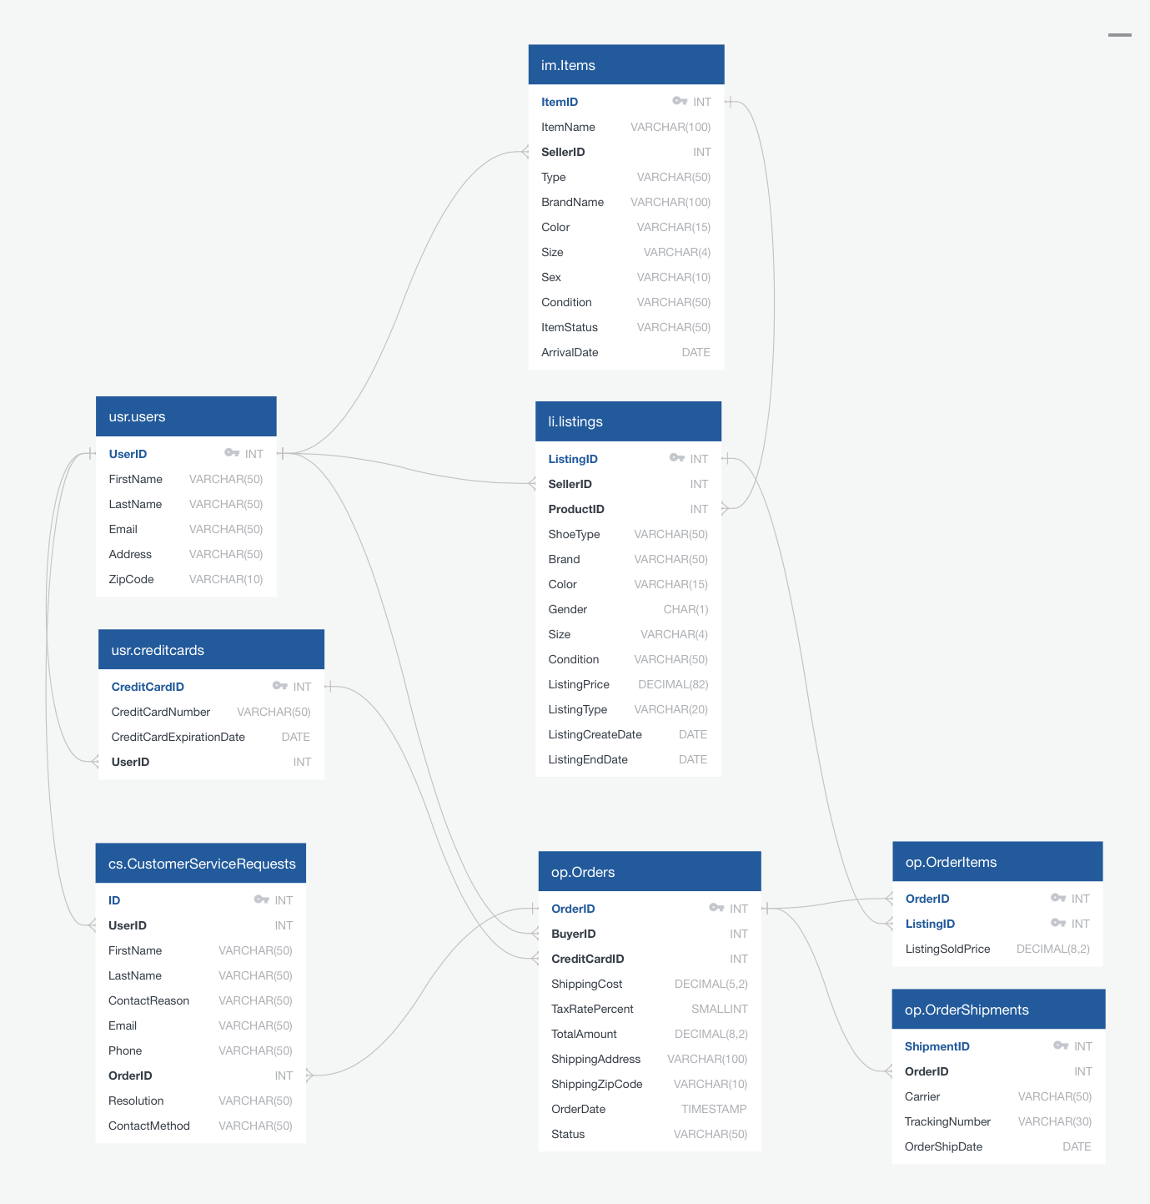
The Enterprise Data Model provides a holistic view of SneakerPark’s data systems and the organization's important entities and relationships.

Slide 6
Step 2
Enterprise Data Catalog Part 2: Metadata

Slide 7
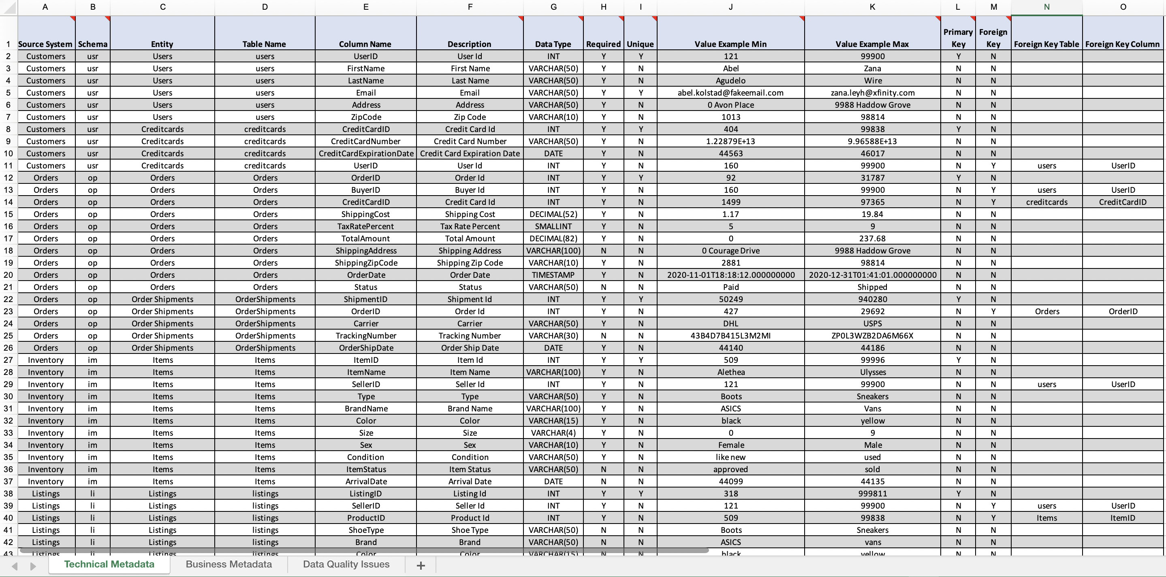
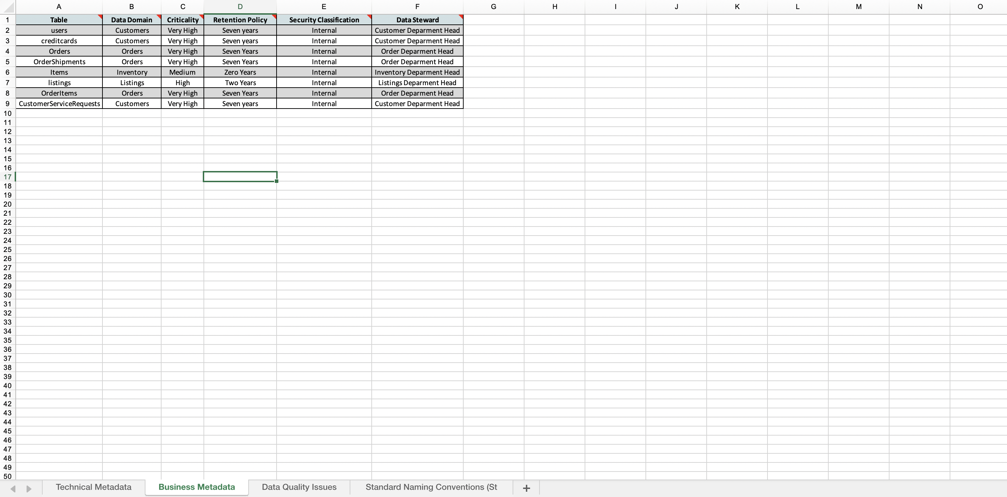
Technical Metadata
Business Metadata

Slide 8
Step 3
Data Quality
Part 1: Profiling and Cleansing

Slide 9
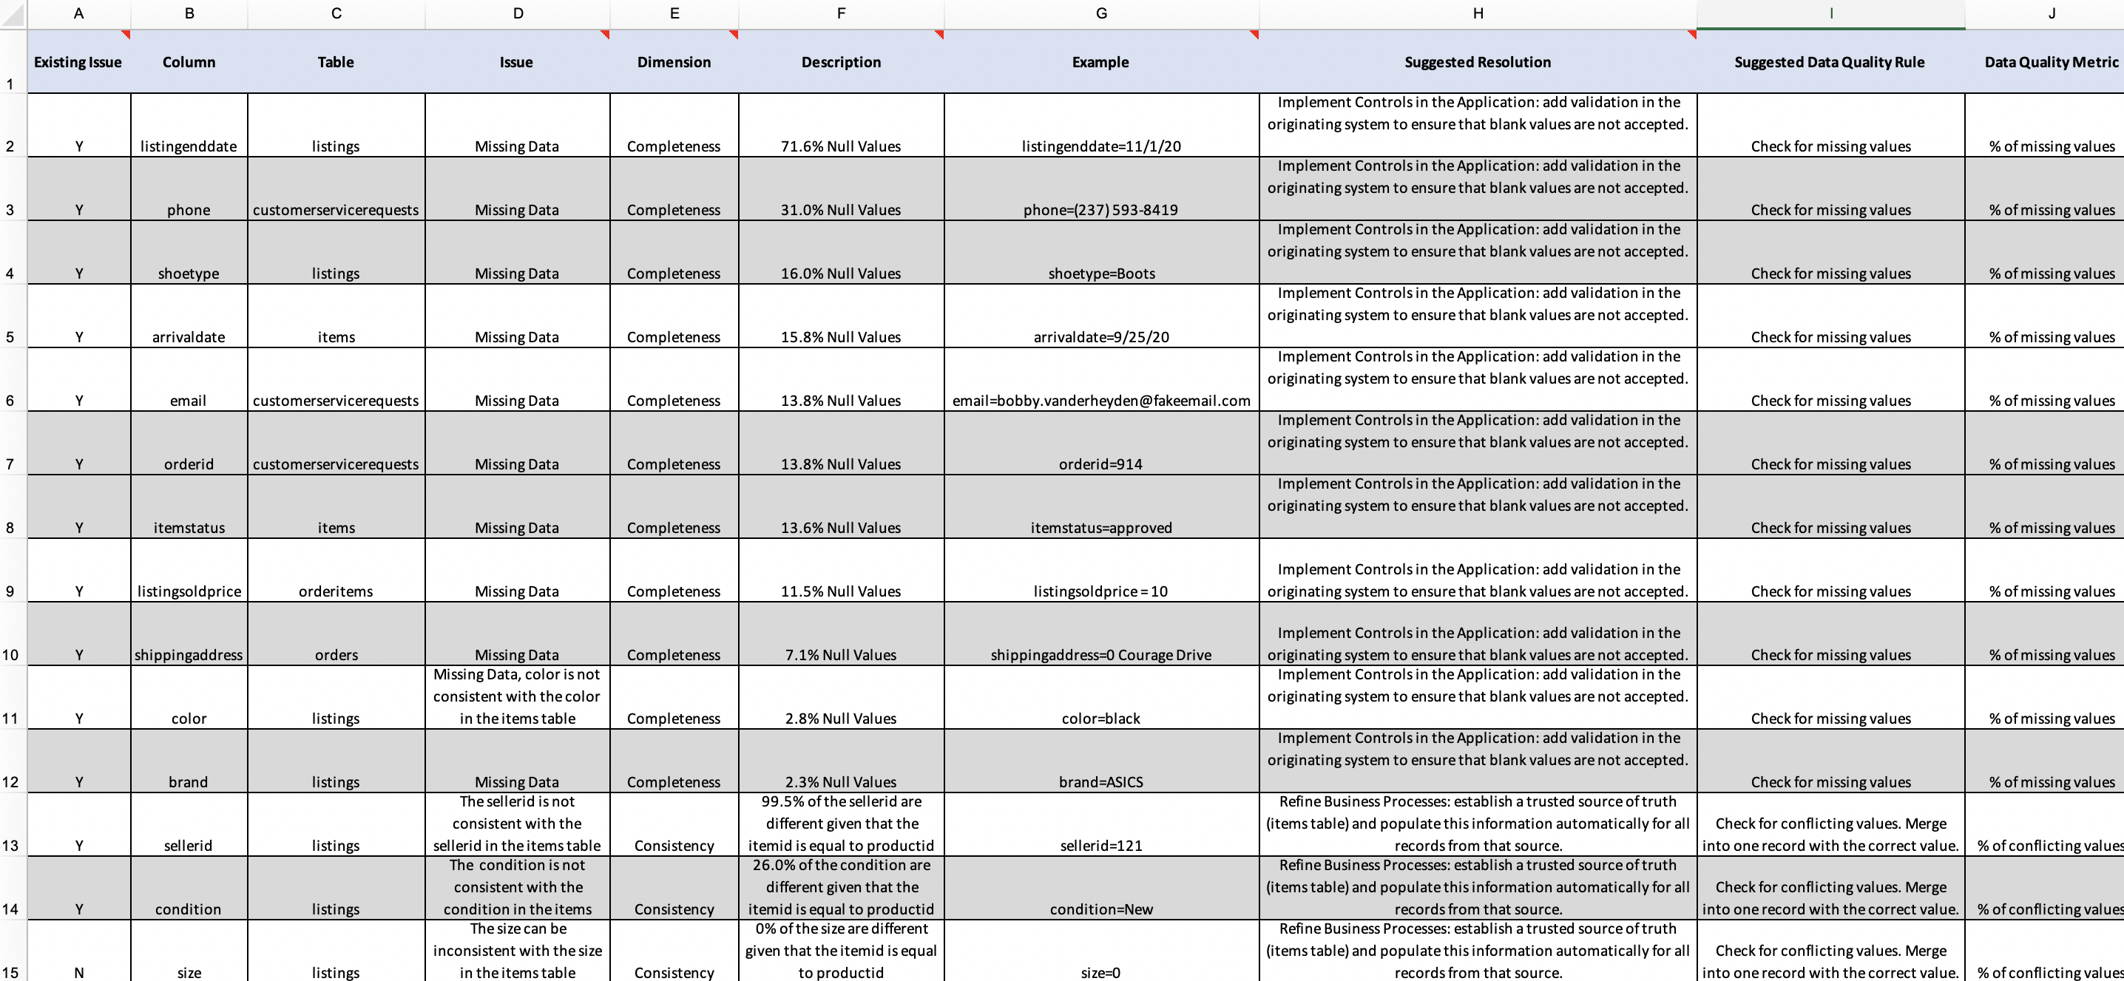
Data quality issues

Slide 10
Step 4
Data Quality
Part 2: Monitoring

Slide 11
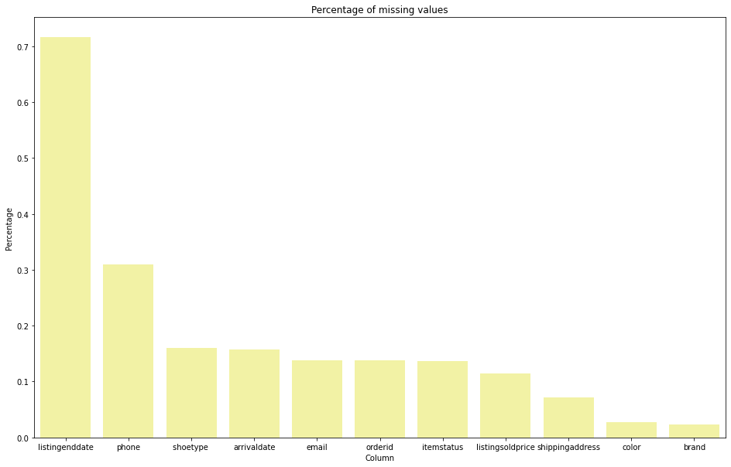
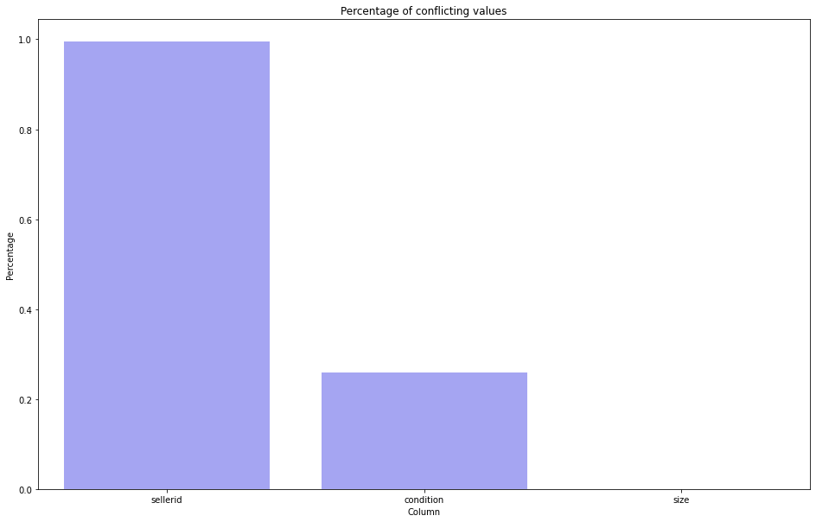
Data quality monitoring dashboard

Slide 12
Step 5
Master Data Management
Part 1: MDM Architecture

Slide 13
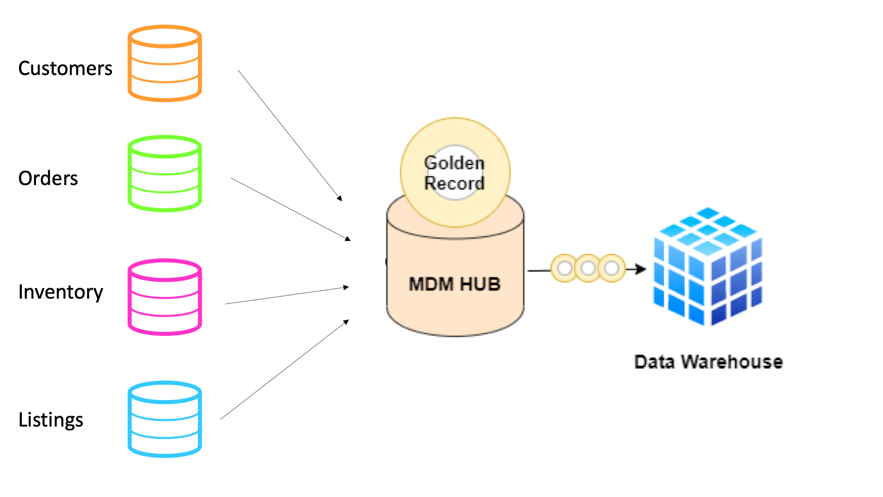
Proposed MDM implementation architecture
I've chosen to go with Consolidated style of architecture. SneakePark has a number of disparate systems that makes it difficult to trace the same item and seller across different systems. The scenario description states that the company plans to build out an Enterprise Data Warehouse solution to replace the existing legacy data warehouse, MS Access databases, and excel reports, which makes me think there are analytical needs. For that reason, I believe consolidating data from all these systems into a central MDM Hub that can feed merged, cleansed, and verified golden records to data warehouses and reports is the best solution here. In addition, this architecture is less invasive and has minimal disruption of existing systems.

Slide 14
Step 6
Master Data Management
Part 2: Master Record

Slide 15
Matching rules that will be used by the SneakerPark's MDM Hub to match item and customer entities between the company's different systems.
For Items:
Match item data on itemid.
Match item data on productid.
For Customers:
Match customer data on userid.
Match customer data on sellerid.
Match customer data on creditcardid.

Slide 16
Step 7
Data Governance:
Roles and Responsibilities

Slide 17
Data governance roles and responsibilities
Data Governance Manager:
Establish and govern an enterprise data governance implementation roadmap including strategic priorities for development of information-based capabilities
Roll out an enterprise wide data governance framework, with a focus on improvement of data quality and the protection of sensitive data through modifications to organization behavior policies and standards, principles, governance metrics, processes, related tools and data architecture
Define roles and responsibilities related to data governance and ensure clear accountability for stewardship of the company’s principal information assets
Serve as a liaison between Business and Functional areas and technology to ensure that data related business requirements for protecting sensitive data are clearly defined, communicated and well understood and considered as part of operational prioritization and planning
Develop & maintain inventory of the enterprise information maps, including authoritative systems, owners

Slide 18
Data governance roles and responsibilities (cont’d)
Data Quality Manager:
Raising data quality and performance levels
Providing a high level of data quality awareness across multiple staff profiles
Proactively improving the quality of company reporting
Evaluating and identifying where system enhancements are required
Master Data Manager:
Design, construct, install, test and maintain highly scalable data pipelines with state-of-the-art monitoring and logging practices.
Bring together large, complex and sparse data sets to meet functional and non-functional business requirements.
Design and implement data tools for analytics and data scientist team members to help them in building, optimizing and tuning the product.
Integrate new data management technologies and software engineering tools into existing structures.
Help in building high-performance algorithms, prototypes, predictive models and proof of concepts.

Slide 19
Data governance roles and responsibilities (cont’d)
Metadata Manager:
Perform business requirements analysis for business rules and documents associated with population and extraction of metadata resources
Develop, maintain, and support application, business glossary, business intelligence, data integration, data modeling, and database management resources
Develop, maintain, and support Metadata Manager Security model
Develop, maintain, and support linkage between Informatica Business Glossary and Metadata Manager assets
Validate completeness of data lineage between the point of data element creation (system of record) and the point where it is consumed by business users (trusted data source
Monitor periodic loads of Metadata Manager resources to confirm successful load, indexing, and linking.
Monitor linking completeness for Metadata Manager resources and troubleshoot issues with missing links.
Provide ongoing support for metadata implementation, testing and integration
Provide technical training and documentation in support of metadata policies and procedures
They are responsible for data profiling, data quality Remediation and data quality monitoring.
They play a critical role in MDM implementation. They define match rules for golden record creation. They review the match results from the automated match process to make sure the result is accurate. They can approve or reject the golden records created by the automated matching algorithms. They can also override match results by manually updating the golden records created by the automated matching algorithms. Data stewards review the rejected records and either identify additional match rules or manually create golden records for these rejections. Finally, they also manually create golden records.
Jake and Jessica have the skills required to fulfill the responsibilities of the data stewards. Other roles include: master data manager, data quality manager, and data governance manager. These are key roles for a successful data governance implementation. Sneaker Park will need to hire new employees to take up additional roles apart from the data steward.

Slide 20
Data governance roles and responsibilities (cont’d)
Data Steward:
Define the data and identify assets within their own data domains. This ensures there isn’t conflict with other data elements.
Create processes and procedures along with access controls to monitor adherence. This includes establishing internal policies and standards—and enforcing those policies.
Maintain quality of the data using customer feedback, concerns, questions; internally reporting metrics; evaluating and identifying issues; and coordinating and implementing corrections regularly.
Optimize workflows and communications.
Monitor data usage to assist teams, share best practice trends in data use, and provide insight into how and where teams can use data to help in day-to-day decision-making.
Ensure compliance and security of the data. Data stewards are responsible for protecting the data—while providing information on potential risks and offering regulatory guidance.
Jake and Jessica have the skills required to fulfill the responsibilities of the data stewards. Sneaker Park will need to hire new employees to take up additional roles apart from the data steward.

